Slide 1
CONVOLUTIONAL NEURAL NETWORKS BASED FIRE DETECTION IN SURVEILLANCE VIDEOS
Sterin Jolly
S7 CSE Btech Roll No: 61
MA College Of Engineering, Kothamangalam
31st October 2018

Slide 2
CONTENTS
CNN BASED FIRE DETECTION IN SURVEILLANCE VIDEOS
Introduction
Existing Methods
CNN Architecture
Applications of CNN
Fire Detection using CNN
Inputs
Results
Effects against different attacks
Conclusion

Slide 3
INTRODUCTION
CNN BASED FIRE DETECTION IN SURVEILLANCE VIDEOS
Need for fire surveillance ?
Detection at early stage can reduce fire disasters.
Requirements for proper fire detection:
Smart surveillance system
Alarm system
Deep Learning for smart surveillance

Slide 4
EXISTING METHODS
CNN BASED FIRE DETECTION IN SURVEILLANCE VIDEOS
Pixel-level
Blob-level
Patch-level
RGB and HSI colour models

Slide 5
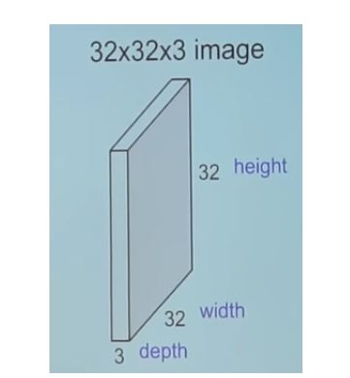
CNN ARCHITECTURE
CNN BASED FIRE DETECTION IN SURVEILLANCE VIDEOS
Deep feed-forward artificial neural network
Made up of neurons
Activation function
Unlike neural networks,
input -> multi-channelled image
https://medium.com/technologymadeeasy/the-best-explanation-of-convolutional-neural-networks-on-the-internet-fbb8b1ad5df8
Notes:
Commonly applied to analysing visual imagery.
Input layer, output layer , hidden layers (conv, pool, FC)

Slide 6
LAYERS OF CNN
CNN BASED FIRE DETECTION IN SURVEILLANCE VIDEOS
Convolutional Layer
Pooling Layer
Fully Connected Layer

Slide 7
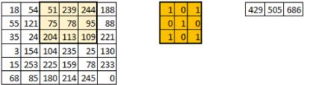
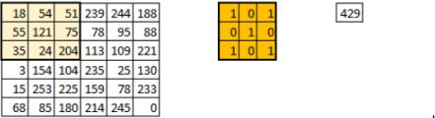
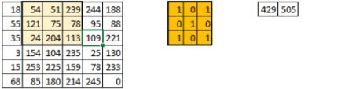
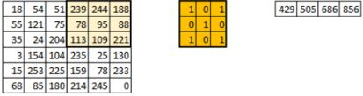
1) CONVOLUTIONAL LAYER
CNN BASED FIRE DETECTION IN SURVEILLANCE VIDEOS
Main building block of CNN
Set of independent filters
Convolution in sequence
Extract features
https://www.analyticsvidhya.com/blog/2017/06/architecture-of-convolutional-neural-networks-simplified-demystified/

Slide 8
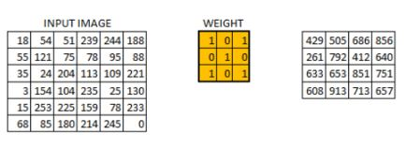
CONVOLUTIONAL LAYER(Contd.)
CNN BASED FIRE DETECTION IN SURVEILLANCE VIDEOS
https://www.analyticsvidhya.com/blog/2017/06/architecture-of-convolutional-neural-networks-simplified-demystified/

Slide 9
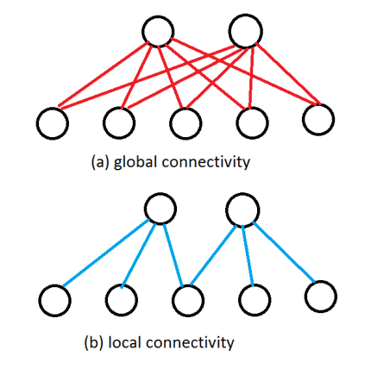
LOCAL CONNECTIVITY
CNN BASED FIRE DETECTION IN SURVEILLANCE VIDEOS
connect each neuron to only a local region of the input volume
Receptive field (filter size)
Output volume = ((W – F + 2P ) / S ) + 1
Size of the output volume depends on:
Depth
Stride
Zero padding
Courtesy:http://cs231n.github.io/convolutional-networks/
Notes:
The spatial extent of this connectivity is a hyperparameter called the receptive field of the neuron (equivalently this is the filter size).

Slide 10
LOCAL CONNECTIVITY(Contd.)
CNN BASED FIRE DETECTION IN SURVEILLANCE VIDEOS
Depth -- number of filters used
Stride -- no. of pixels the filter slides
-- controls how filter convolves around input volume
Zero Padding -- pads input volume with zeroes
Filter (weight matrix)
-- extracts information from original image
Activation map / feature map

Slide 11
PARAMETER SHARING
CNN BASED FIRE DETECTION IN SURVEILLANCE VIDEOS
control the number of parameters
if one feature is useful to compute at (x,y), then same at (x2,y2).
volume of size [55x55x96] has 96 depth slices, each of size [55x55]
neurons in each depth slice to use the same weights and bias
Notes:
In practice during backpropagation, every neuron in the volume will compute the gradient for its weights, but these gradients will be added up across each depth slice and only update a single set of weights per slice.

Slide 12
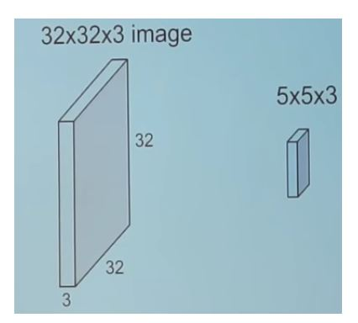
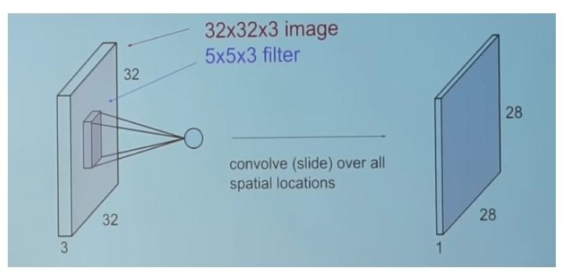
CONVOLVING
CNN BASED FIRE DETECTION IN SURVEILLANCE VIDEOS
https://medium.com/technologymadeeasy/the-best-explanation-of-convolutional-neural-networks-on-the-internet-fbb8b1ad5df8

Slide 13
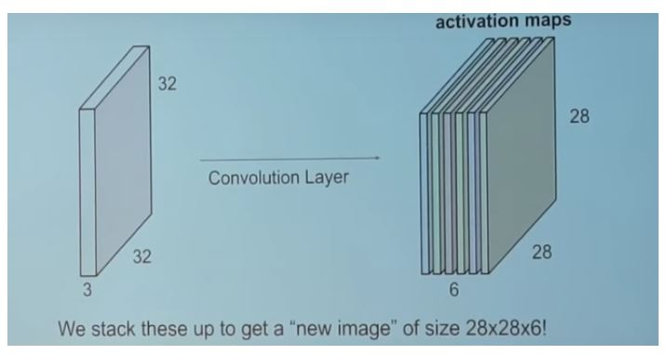
CONVOLVING(Contd.)
CNN BASED FIRE DETECTION IN SURVEILLANCE VIDEOS
https://medium.com/technologymadeeasy/the-best-explanation-of-convolutional-neural-networks-on-the-internet-fbb8b1ad5df8

Slide 14
2)POOLING LAYERS
CNN BASED FIRE DETECTION IN SURVEILLANCE VIDEOS
periodically insert a Pooling layer in-between successive Conv layers
Progressively reduce spatial size of representation
Reduce amount of parameters and computation
Operates on each feature map independently
Max pooling, Avg pooling
Notes:
http://cs231n.github.io/convolutional-networks/

Slide 15
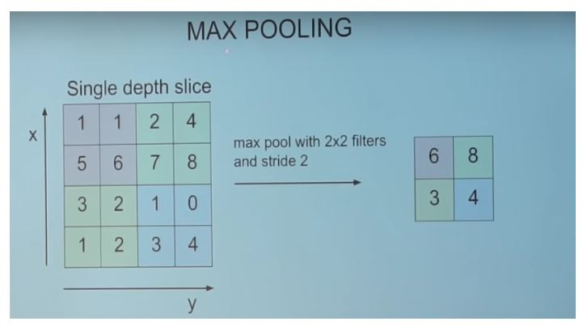
MAX POOLING
CNN BASED FIRE DETECTION IN SURVEILLANCE VIDEOS
Input Volume = W1 x H1 X D1
Output Volume = W2 x H2 X D2
W2= (W1-F)/S+1
H2= (H1-F)/S+1
D2= D1
https://medium.com/technologymadeeasy/the-best-explanation-of-convolutional-neural-networks-on-the-internet-fbb8b1ad5df8

Slide 16
3)FULLY CONNECTED LAYER
CNN BASED FIRE DETECTION IN SURVEILLANCE VIDEOS
Similar to normal neural network layer
Fully connected neurons at end of CNN
Full connections to all activations in previous layer

Slide 17
APPLICATIONS OF CNN
CNN BASED FIRE DETECTION IN SURVEILLANCE VIDEOS
Image recognition
Video analysis
Natural Language Processing
Gesture Classification

Slide 18
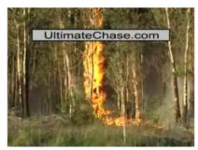
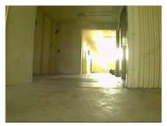
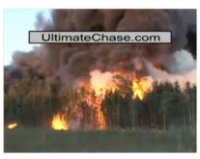
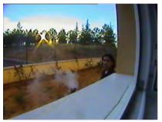
INPUT – FIRE INPUT -NORMAL
CNN BASED FIRE DETECTION IN SURVEILLANCE VIDEOS
Courtesy: https://ieeexplore.ieee.org/document/8307064/

Slide 19
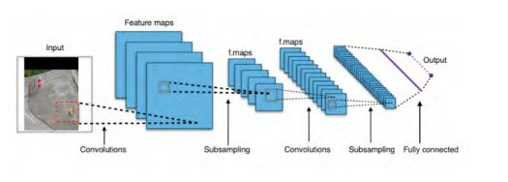
CNN FIRE DETECTION
CNN BASED FIRE DETECTION IN SURVEILLANCE VIDEOS
Similar to GoogleNet
No of layers : 100
2 main convolutions
4 max pooling
7 inception layers
Courtesy: https://ieeexplore.ieee.org/document/8307064/

Slide 20
CNN FIRE DETECTION(Contd.)
CNN BASED FIRE DETECTION IN SURVEILLANCE VIDEOS
1st Convolution
Input : 224 x 224 x 3
Stride : 2
Filter size : 7 x 7
No of filters : 64
Output : 112x 112 x 64
1st Pooling
Input : 112 x 112 x 64
Stride : 2
Filter size : 3 x 3

Slide 21
GOOGLENET (INCEPTION)
CNN BASED FIRE DETECTION IN SURVEILLANCE VIDEOS
Why GoogleNet and not AlexNet?
ILSVRC 2014 winner
Better classification accuracy
Small sized model
Suitability of implementation on FPGAs
Notes:
The imageNet project is a large visual database designed for use in visual object recognition software research.
The ImageNet project runs an annual software contest, the ImageNet Large Scale Visual Recognition Challenge (ILSVRC) .
GoogleNet top error rate of 6.67%. Their architecture consisted of a 22 layer deep CNN but reduced the number of parameters from 60 million (AlexNet) to 4 million.
AlexNet error rate 15%

Slide 22
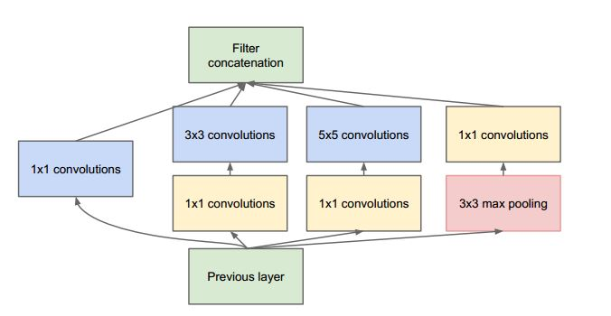
GOOGLENET (Contd.)
CNN BASED FIRE DETECTION IN SURVEILLANCE VIDEOS
approximates a sparse CNN with a normal dense construction
uses convolutions of different size (5X5, 3X3, 1X1).
Courtesy: https://cv-tricks.com/cnn/understand-resnet-alexnet-vgg-inception/
Notes:
uses convolutions of different size to capture details at different scales.
Deep neural networks – computationally expensive.
Limit the no of input channels by adding an extra 1x1 convolution, before 3x3 and 5x5.

Slide 23
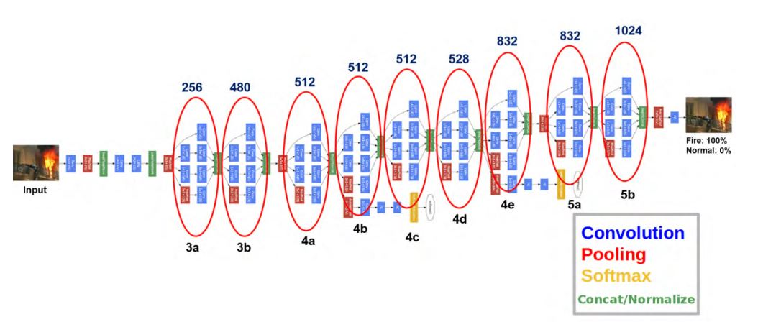
CNN FIRE DETECTION(Contd.)
CNN BASED FIRE DETECTION IN SURVEILLANCE VIDEOS
Courtesy: https://ieeexplore.ieee.org/document/8307064/

Slide 24
SOFTMAX FUNCTION
applied to the very last layer in a neural net
instead of using sigmoid, tanh, or another activation function.
converts output of last layer in neural network into a probability distribution.
Notes:
.

Slide 25
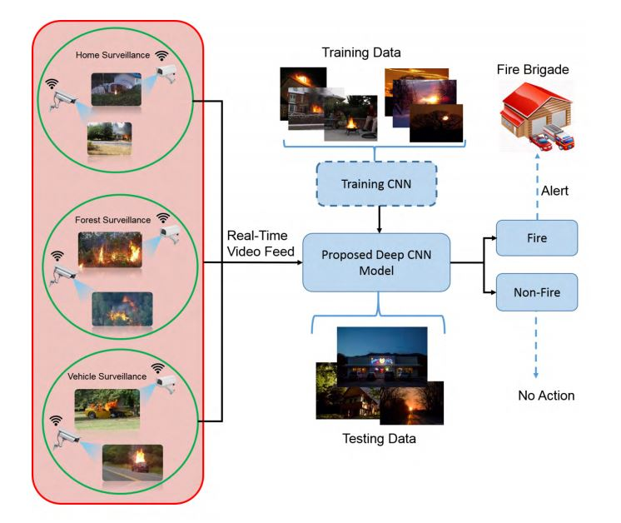
CNN BASED FIRE DETECTION IN SURVEILLANCE VIDEOS
CNN FIRE DETECTION
Courtesy: https://ieeexplore.ieee.org/document/8307064/

Slide 26
RESULTS
CNN BASED FIRE DETECTION IN SURVEILLANCE VIDEOS
Data set 1
31 videos : 14 fire & 17 normal
Accuracy : 93.55%
False alarms : 11.67%
Data set 2
226 images : 119 fire & 107 normal
Precision : 0.86
Recall : 0.98
Notes:
Accuracy
Accuracy = ( true positive + true negative ) / N N : total no of data
Precision – out of those predicted positive, how many are actual positive
Precision = true positive / ( true positive + false positive )
Recall
Recall = true positive / ( true positive + false negative )

Slide 27
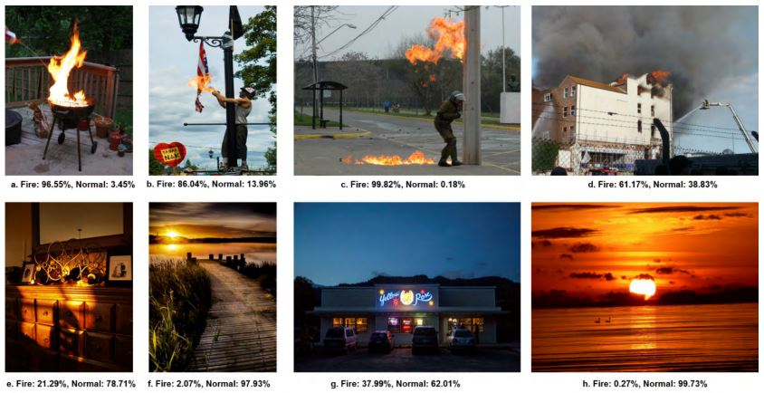
RESULTS(Contd.)
CNN BASED FIRE DETECTION IN SURVEILLANCE VIDEOS
Courtesy: https://ieeexplore.ieee.org/document/8307064/

Slide 28
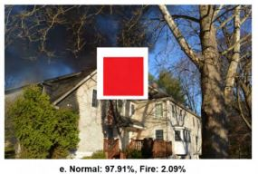
EFFECT ON PERFORMANCE AGAINST DIFFERENT ATTACKS
CNN BASED FIRE DETECTION IN SURVEILLANCE VIDEOS
Correctly classifies distorted fire images
Predicts fire-coloured regions as normal
Fire detection possible
in presence of noise
at reasonable distance
amount of fire is small
Courtesy: https://ieeexplore.ieee.org/document/8307064/

Slide 29
CONCLUSION
CNN BASED FIRE DETECTION IN SURVEILLANCE VIDEOS
Used DL architecture with CNN framework for fire detection
Trained a model similar to GoogleNet
Balances accuracy and computational complexity
Reduces no of false warnings

Slide 30
REFERENCES
CNN BASED FIRE DETECTION IN SURVEILLANCE VIDEOS
[1] K. Muhammad, R. Hamza, J. Ahmad, J. Lloret, H. H. Ge Wang, and S. W. Baik, ‘‘secure surveillance framework for IoT systems using probabilistic image encryption,’’ IEEE Trans. Ind. Inform., to be published, doi: https://doi.org/10.1109/TII.2018.2791944
[2] K. Muhammad, J. Ahmad, and S. W. Baik, ‘‘Early fire detection using convolutional neural networks during surveillance for effective disaster management,’’ Neurocomputing, vol. 288, pp. 30–42, May 2018. [Online]. Available: https://www.sciencedirect.com/science/article/pii/ S0925231217319203
[3] J. Choi and J. Y. Choi, ‘‘An integrated framework for 24-hours fire detection,’’ in Proc. Eur. Conf. Comput. Vis., 2016, pp. 463–479.
[4] H. J. G. Haynes. (2016). Fire Loss in the United States During 2015. [Online]. Available: http://www.nfpa.org/

Slide 31
REFERENCES(Contd.)
CNN BASED FIRE DETECTION IN SURVEILLANCE VIDEOS
[5] C.-B. Liu and N. Ahuja, ‘‘Vision based fire detection,’’ in Proc. 17th Int. Conf. Pattern Recognit. (ICPR), Aug. 2004, pp. 134–137.
[6] T.-H. Chen, P.-H. Wu, and Y.-C. Chiou, ‘‘An early fire-detection method based on image processing,’’ in Proc. Int. Conf. Image Process. (ICIP), Oct. 2004, pp. 1707–1710.
[7] B. U. Töreyin, Y. Dedeoğlu, U. Güdükbay, and A. E. Çetin, ‘‘Computer vision based method for real-time fire and flame detection,’’ Pattern Recognit. Lett., vol. 27, pp. 49–58, Jan. 2006.
[8] J. Choi and J. Y. Choi, ‘‘Patch-based fire detection with online outlier learning,’’ in Proc. 12th IEEE Int. Conf. Adv. Video Signal Based Surveill. (AVSS), Aug. 2015, pp. 1–6.

Slide 32
CNN BASED FIRE DETECTION IN SURVEILLANCE VIDEOS
THANK YOU

